Slide 1

The Art of Body Language in Public Speaking
By AZMAIN FAYEK.
ID : 2023200000536

Slide 2
WE WILL LEARN FROM THIS PRESENTATION
Importance of Body Language.
Key Elements
Common Body Language
Breakdown of Communication
Elements of Confident Body Language
Interpreting Audience Signals
Improving Techniques
Conclusion & Summary

Slide 3

Importance of Body Language
Non-verbal communication
Body language accounts for a significant portion of communication, influencing how messages are perceived. It can reinforce or contradict verbal messages, making its mastery crucial for effective public speaking.

Slide 4
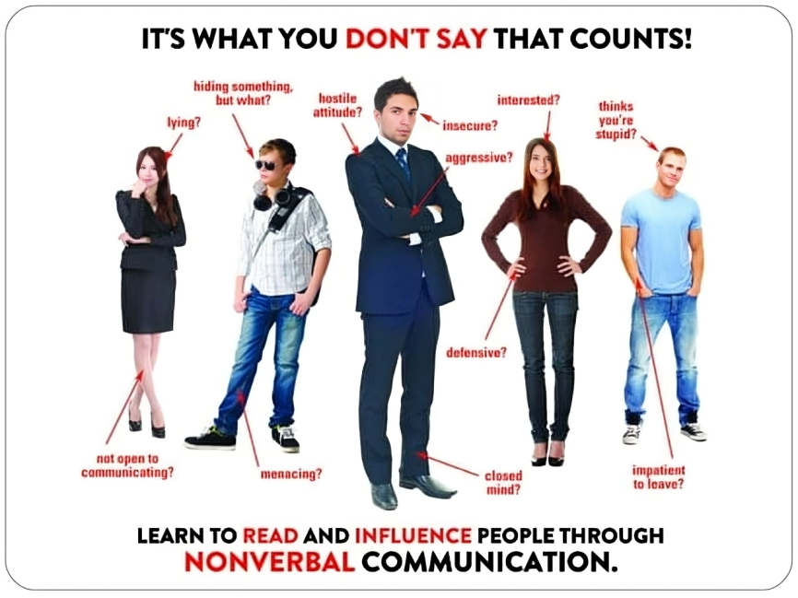

Slide 5


Key Elements
Eye contact
Direct eye contact creates a connection with the audience, fostering trust. It’s essential for keeping listeners engaged.
Posture and stance
The way you stand can convey confidence and authority. Good posture helps project your voice and can engage the audience.

Slide 6

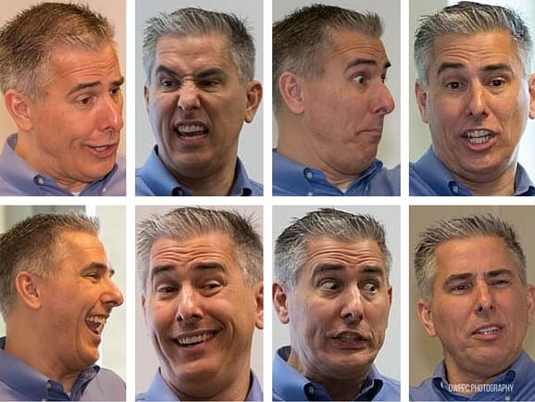
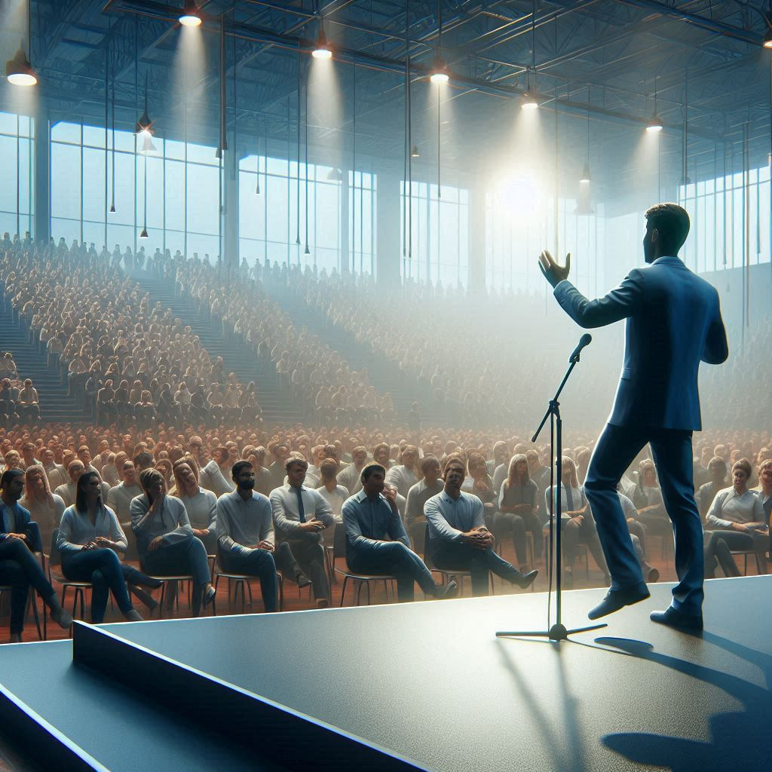
Common Body Language
Hand gestures
Purposeful hand movements can emphasize points and convey enthusiasm. Avoiding fidgeting helps project calmness.
Facial expressions
A genuine smile or concerned expression helps to match the tone of the message being delivered. They are crucial for establishing emotional connections.
Movement on stage
Moving purposefully can engage the audience better. However, pacing should be mindful to avoid distraction.

Slide 7
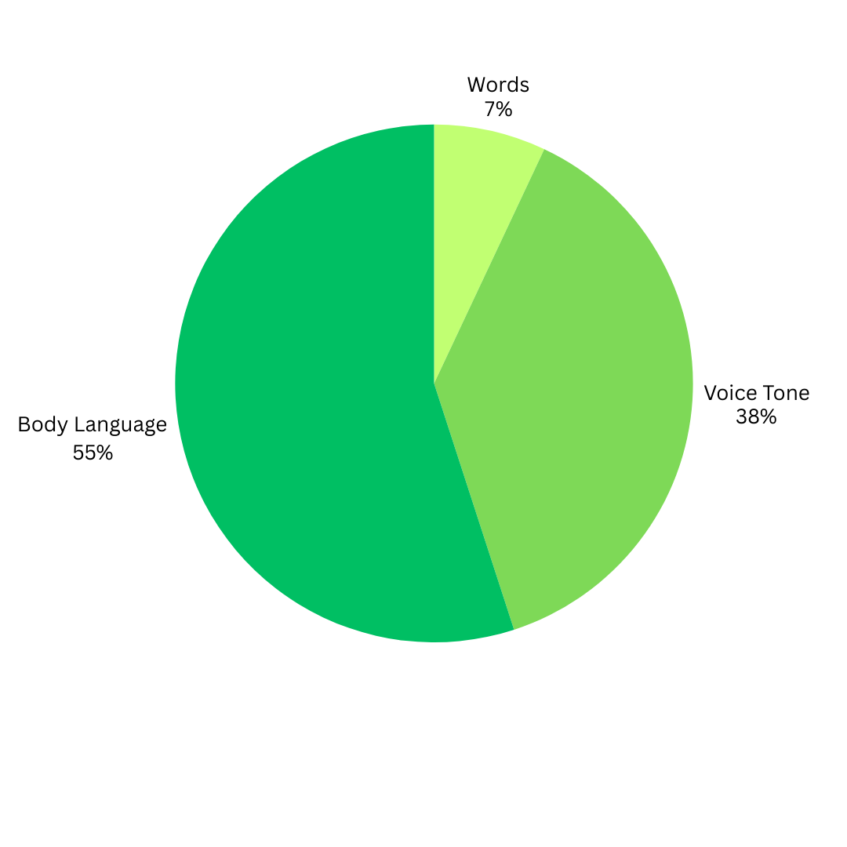


Body language includes the gestures, postures, movements and expressions that a person uses to communicate.
7 % VERBAL (Conveyed through words)
38% VOCAL (intonation, pitch, pauses, etc.)
55% NON VERBAL (body language)

Slide 8
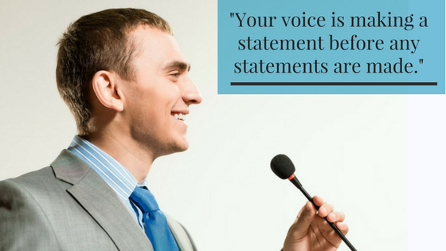
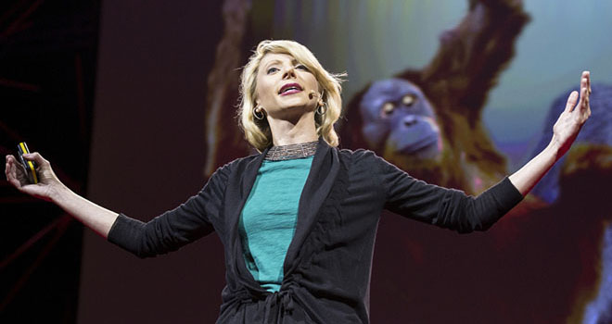
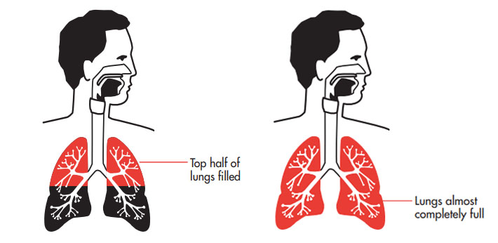


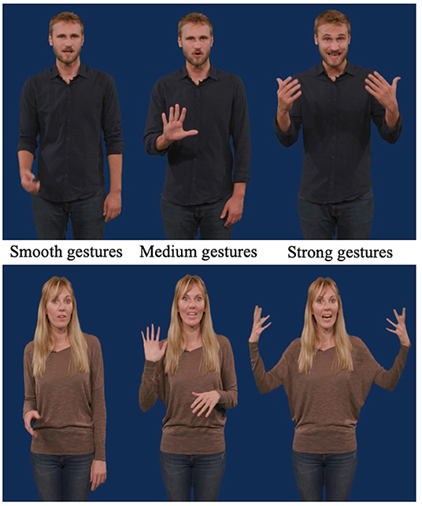

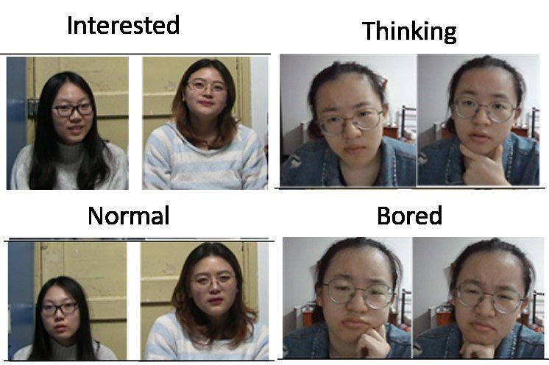
8 Elements of Confident Body Language
Power pose
Voice
Breathing
Eye contact
Mannerisms
Hand gestures
Movement
Expressions

Slide 9

Interpreting Signals(AUDIENCE)
Reading the audience
Observing audience body language can provide insight into their engagement level.
Fidgeting or Pacing
Excessive movement may indicate nervousness or lack of confidence.
Crossed Arms
Can seem defensive or closed-off, reducing engagement.
Avoiding Eye Contact
May signal uncertainty or disconnection.
Tightly Clenched Hands
Shows tension and stress.

Slide 10

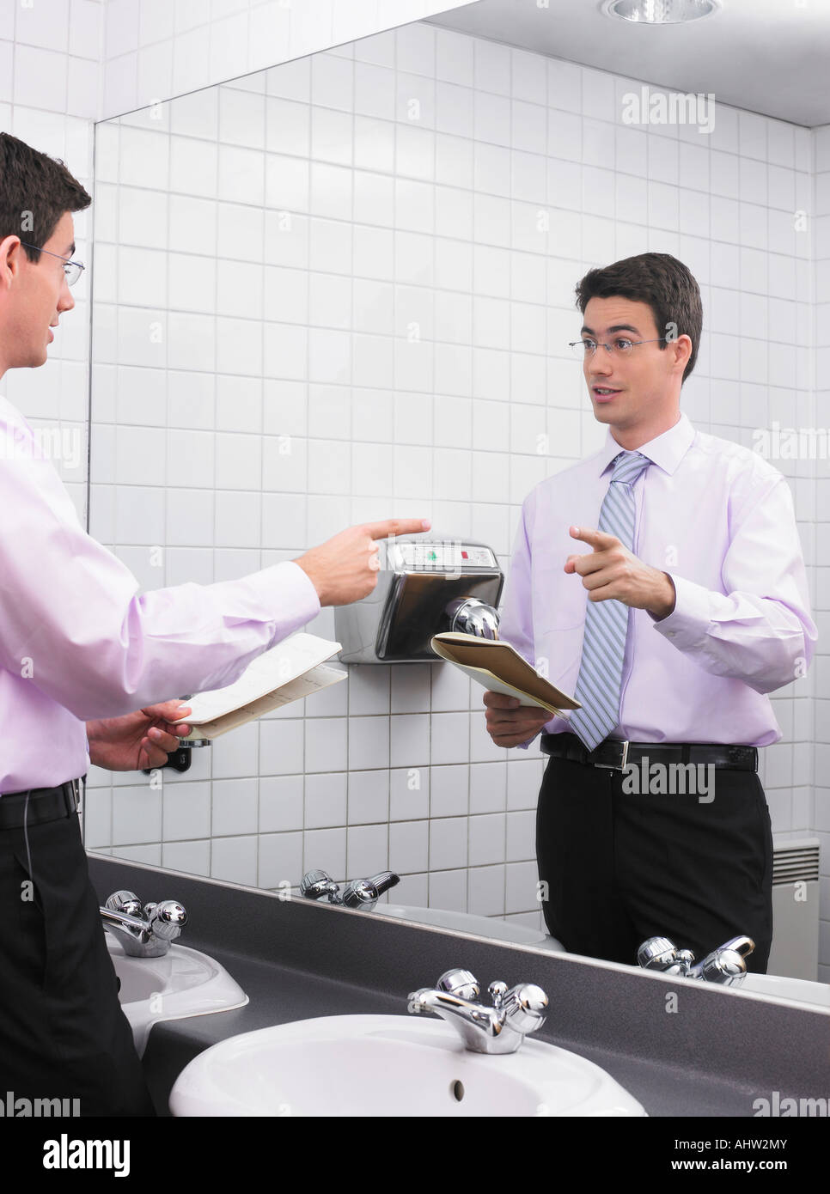
Improving Techniques
Practice in front of a mirror
Rehearsing gestures and facial expressions can build awareness and confidence in using body language effectively.
Record and review presentations
Watching recordings helps identify areas for improvement, allowing speakers to fine-tune their body language during speeches.

Slide 11
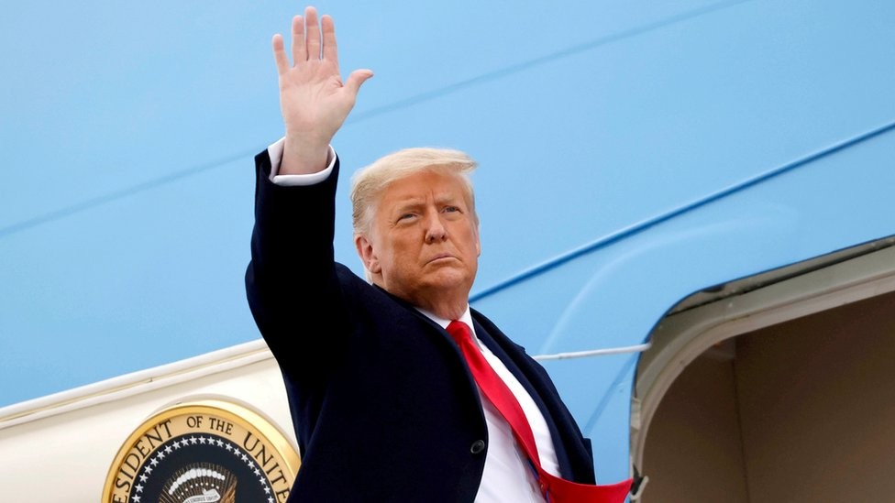
Conclusion & Summary
Key takeaways
Body language plays a crucial role in public speaking, influencing both speaker confidence and audience perception. Mastery of body language skills enhances overall communication efficacy.
Conclusion
Body language is a powerful tool in public speaking—it enhances confidence, credibility, and
audience connection. By using strong posture, purposeful gestures, and expressive eye contact,
speakers can deliver more impactful messages.
Master your body language, and your words will be even more influential.

Slide 12

DO YOU HAVE ANY QUESTION?

